Slide 1


Hasan Soufan
09/12/2022

Slide 2

Outline
Executive Summary
Introduction
Methodology
Results
Conclusion
Appendix

Slide 3
Executive Summary
SpaceX Falcon 9 First Stage Landing Prediction.
SpaceY want to reduce its spending by studding SpaceX data and figure out how they can return the first stage of their rocket safely and try to predict the outcome of this process with different situation.
Starting by collecting data from their apis and from scrapping Wikipedia, then doing a data wrangling find patterns in the data like (Launches Sites, Orbits and Landing Outcomes).
Using Exploratory Data Analysis (EDA) and interactive visual analytics find relations and information between the standards and the Outcomes like (Flight Number, Payload and Orbit).
Performing a predictive analysis then building a classification models and evaluate them, and choice the best one based on metrics like Accuracy and confusion matrix, which gives 83% of certainty when its prediction the Outcomes.
The results are SpaceY can figure out what standards that has an effect on the landing process and predict whether their Rocket first stage will landing safety or not with 83% of certainty.

Slide 4
Introduction
SpaceX (a sciences space company ) spend less than others on their space flights because they try to return and land the first stage of their rockets safely, but this process doesn’t work every time, it’s depend on many features, like (Launch Site, Destination, the Rocket Version … etc.), this project is to figure out how SpaceY can reduce its spending based on studding SpaceX data.
Depending on the previous standards we want to study SpaceX data trying to figure out:
What and how features effect the landing process.
build a prediction mechanism to find wither the first stage will land successfully or not based on different situation.

Slide 5

Section 1

Slide 6
Methodology
Executive Summary
Data collection, Data was collected using Spacex Apies and web scraping.
data wrangling found patters in data like Launches Sites, Orbits and Landing Outcomes.
Exploratory data analysis (EDA) using visualization and SQL show the features that have a relation with the Landing Outcomes like (Flight Number, Payload and Orbit).
interactive visual analytics: using Folium map and Plotly Dash appear the distribution of the Launches Sites and the Landing Outcomes for each site, their percent of success and failure, the relation with the payload and the booster.
Performing predictive analysis: by building a classification models like Logistic Regression, Support Vector Machine and Others models, evaluated by Confusion Matrix and Accuracy.

Slide 7
Data Collection
data sets were collected from Spacexs apis and Wikipedia.
At first downloading data from the sources.
Next extracting data that relate to the issues.
Then save the data in relational form.

Slide 8
Data Collection – SpaceX API
Data Collected by Spacex APIs, with just Falcon 9* Booster Version.
GitHub URL for SpaceX API calls file.
Flight Number | Date | BoosterVersion | PayloadMass | Orbit | LaunchSite | Outcome | Flights | GridFins | Reused | Legs | LandingPad | Block | ReusedCount | Serial | Longitude | Latitude
4 | 1 | 2010-06-04 | Falcon 9 | NaN | LEO | CCSFS SLC 40 | None None | 1.0 | False | False | False | None | NaN | 0 | Merlin2C | -80.577366
5 | 2 | 2012-05-22 | Falcon 9 | 525.0 | LEO | CCSFS SLC 40 | None None | 1.0 | False | False | False | None | NaN | 0 | Merlin3C | -80.577366
6 | 3 | 2013-03-01 | Falcon 9 | 677.0 | ISS | CCSFS SLC 40 | None None | 1.0 | False | False | False | None | 1.0 | 0 | B0003 | -80.577366
7 | 4 | 2013-09-29 | Falcon 9 | 500.0 | PO | VAFB SLC 4E | False Ocean | 1.0 | False | False | False | None | 1.0 | 0 | B0005 | -120.610829
8 | 5 | 2013-12-03 | Falcon 9 | 3170.0 | GTO | CCSFS SLC 40 | None None | 1.0 | False | False | False | None | 1.0 | 0 | B0007 | -80.577366
* Falcon 9 is a space rocket for tesla

Slide 9
Data Collection - Scraping
Data Collected by scrapping Wikipedia Falcon 9* historical launch records.
GitHub URL for web scraping notebook file
Flight No. | Launch site | Payload | Payload mass | Orbit | Customer | Launch outcome | Launch Site | Version Booster | Booster landing | Date | Time
0 | 1 | NaN | Dragon Spacecraft Qualification Unit | 0 | LEO | SpaceX | Success\n | CCAFS | F9 v1.0B0003.1 | Failure | 4 June 2010
1 | 1 | NaN | Dragon | 0 | LEO | NASA | Success | CCAFS | F9 v1.0B0003.1 | Failure | 4 June 2010
2 | 2 | NaN | Dragon | 525 kg | LEO | NASA | Success | CCAFS | F9 v1.0B0004.1 | No attempt\n | 8 December 2010
3 | 3 | NaN | SpaceX CRS-1 | 4,700 kg | LEO | NASA | Success\n | CCAFS | F9 v1.0B0005.1 | No attempt | 22 May 2012
4 | 4 | NaN | SpaceX CRS-2 | 4,877 kg | LEO | NASA | Success\n | CCAFS | F9 v1.0B0006.1 | No attempt\n | 8 October 2012
* Falcon 9 is a space rocket for tesla

Slide 10
Data Wrangling
Dealing with Null values.
Figuring out the following:
Launches in each Site.
Launches to each Orbit*.
Outcomes per Orbit type.
Create label Outcome column with 1 for success and 0 for failure by encode the (Outcome) values.
GitHub URL for Data Wrangling file
* Orbit is the curved path of a celestial object or spacecraft

Slide 11
EDA with Data Visualization
Scatter Plots: figuring out the relationships between the following features and their effect on the Launch Outcomes
(Flight Number) vs (Payload).
(Flight Number) vs (Launch Site).
(Payload) vs (Launch Site).
(Flight Number) vs (Orbit)
(Payload) vs (Orbit).
Bar Chart: determine the relationship between success rate of each )Orbit) type.
Line Chart: visualize the launch success yearly trend
GitHub URL for EDA visualization file.

Slide 12
EDA with SQL
the names of the unique launch sites in the space mission.
the first 5 records where the Launch Site begin with ‘CCA’.
the total Payload Carried by Boosters Launched by NASA.
average Payload carried by Booster Version F9 v1.1.
the Date of the first success landing Outcome achieved.
the Boosters that have a Payload between 4000 – 6000 and Landed successfully in drone ship.
the total number of successful and failure mission Outcome.
booster versions which have carried the maximum Payload.
failed Landing outcome in drone ship, their booster version and Launch Site in 2015
the total Landing Outcome between 2010 – 2017 in descending.
GitHub URL for EDA with SQL file.

Slide 13
Build an Interactive Map with Folium
Cluster Markers were created for each (Launch Site) to cluster its information.
Circles on each Site to show its location.
Markers for each success/failed Launches with green/red colors to display each Site Launches success rate.
Lines between Launch Sites and railways, highways, cities and coastlines, to study its location.
GitHub URL for Folium map file.

Slide 14
Build a Dashboard with Plotly Dash
Plots, graphs and interactions added to a dashboard
Dropdown list for enable (Launch Site) selection.
Slider select the (Payload) range.
Pie Chart show the total successful launch for all sites and if specific site was selected view the sites success vs failed launches.
Scatter chart show the correlation between the (Payload) and the launch success with determining the (Booster Version).
GitHub URL for Plotly Dash file.

Slide 15
Predictive Analysis (Classification)
Standardize and Normalize the Data to keep it in the same range because the models used minkowski distance like Euclidean and Manhattan .
Split the data set into train and test data to test the models and have a certainty with samples out of the range.
Using Grid Search and Cross-Validation to test each model with multiple situations to figure out the best one.
Using metrics like Confusion Matrix and Accuracy to evaluate the models and select the best model.
GitHub URL predictive analysis file.

Slide 16
Results
Exploratory data analysis show that:
the first stage is more likely to landing successfully when (flight number) increase and (Payload) decrease, When (launches sites) are (VAFB SLC 4E – KSC LC 39A), when the Orbit type is (LEO – VLEO - SSO) and the average rate increase as the years increase.
Interactive analytics show that:
the first stage is more likely to landing successfully when (launches sites) are (KSC LC 39A), the Payload decrease, and version of the Booster is (FT).
Fail Landing is more likely to happen when (v1.1) booster version is use.
All Launch sites has more than 50% of success Outcome
Predictive analysis show that:
more than one classification model can predict the Outcomes status with 83% of certainty.

Slide 17

Section 2

Slide 18
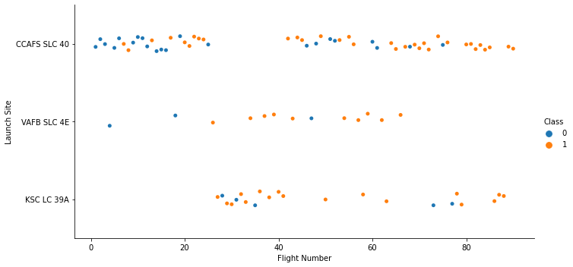
Flight Number vs. Launch Site
When (Flight Number) increase the first stage is more likely to landing successfully specially with (VAFB SLC-4E) and (KSC LC-39A) (Launch Sites).

Slide 19
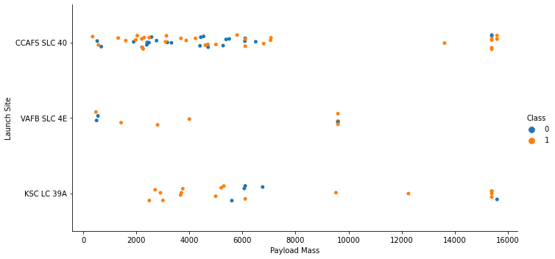
Payload vs. Launch Site
the first stage is more likely to landing successfully when using (KSC LC 39A) (Launch Sites), and when the (Payload) decrease.

Slide 20
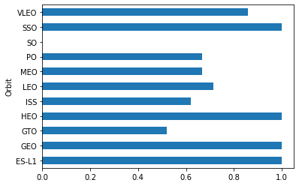
Success Rate vs. Orbit Type
the probability of landing successfully with (Orbit),it is more likely when the Orbit types are (SSO – HEO – GEO – ES-L1 - VLEO)

Slide 21
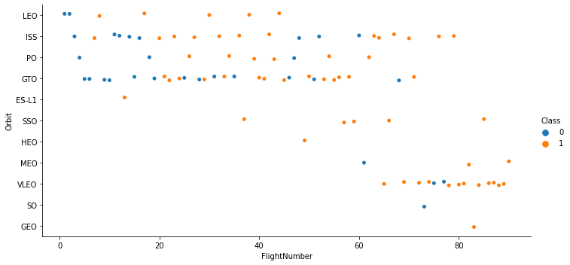
Flight Number vs. Orbit Type
the first stage is more likely to landing successfully when (Flight Number) increase and the (Orbit) is one of (VLEO – LEO - SSO).

Slide 22
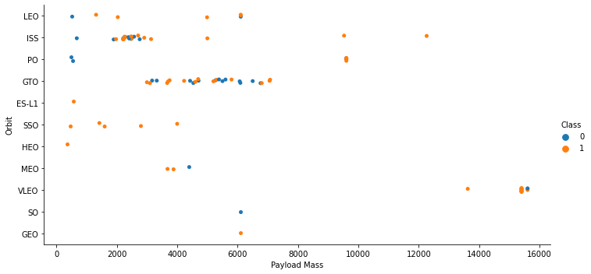
Payload vs. Orbit Type
the first stage is more likely to landing successfully when (Payload) decrease and the (Orbit) is one of (SSO - LEO)

Slide 23
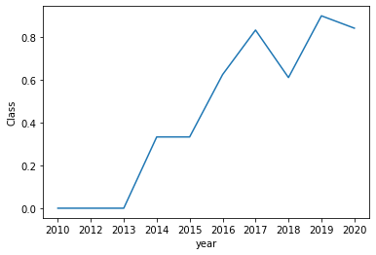
Launch Success Yearly Trend
As the years increase the first stage is more likely to landing successfully.

Slide 24
All Launch Site Names
launch_site
CCAFS LC-40
CCAFS SLC-40
KSC LC-39A
VAFB SLC-4E

Slide 25
Launch Site Names Begin with 'CCA'
DATE | Time utc | Booster version | Launch site | payload | Payload mass kg | orbit | customer | Mission outcome | Landing outcome
04-06-2010 | 18:45:00 | F9 v1.0 B0003 | CCAFS LC-40 | Dragon Spacecraft Qualification Unit | 0 | LEO | SpaceX | Success | Failure (parachute)
08-12-2010 | 15:43:00 | F9 v1.0 B0004 | CCAFS LC-40 | Dragon demo flight C1, two CubeSats, barrel of Brouere cheese | 0 | LEO (ISS) | NASA (COTS) NRO | Success | Failure (parachute)
22-05-2012 | 07:44:00 | F9 v1.0 B0005 | CCAFS LC-40 | Dragon demo flight C2 | 525 | LEO (ISS) | NASA (COTS) | Success | No attempt
08-10-2012 | 00:35:00 | F9 v1.0 B0006 | CCAFS LC-40 | SpaceX CRS-1 | 500 | LEO (ISS) | NASA (CRS) | Success | No attempt
01-03-2013 | 15:10:00 | F9 v1.0 B0007 | CCAFS LC-40 | SpaceX CRS-2 | 677 | LEO (ISS) | NASA (CRS) | Success | No attempt

Slide 26
Total Payload Mass
NASA TOTAL PAYLOADS
45596

Slide 27
Average Payload Mass by F9 v1.1
AVG PAYLOADS
2928 KG

Slide 28
First Successful Ground Landing Date
Min DATE
01-05-2017

Slide 29
Successful Drone Ship Landing with Payload between 4000 and 6000
Booster version
F9 FT B1022
F9 FT B1026
F9 FT B1021.2
F9 FT B1031.2

Slide 30
Total Number of Successful and Failure Mission Outcomes
Mission Outcomes
101

Slide 31
Boosters Carried Maximum Payload
Booster version
F9 B5 B1048.4
F9 B5 B1049.4
F9 B5 B1051.3
F9 B5 B1056.4
F9 B5 B1048.5
F9 B5 B1051.4
F9 B5 B1049.5
F9 B5 B1060.2
F9 B5 B1058.3
F9 B5 B1051.6
F9 B5 B1060.3
F9 B5 B1049.7

Slide 32
2015 Launch Records
Landing outcome | Booster version | Launch site
Failure (drone ship) | F9 v1.1 B1012 | CCAFS LC-40
Failure (drone ship) | F9 v1.1 B1015 | CCAFS LC-40

Slide 33
Rank Landing Outcomes Between 2010-06-04 and 2017-03-20
Landing outcome | Count
Controlled (ocean) | 5
Failure | 3
Failure (drone ship) | 5
Failure (parachute) | 2
No attempt | 22
Precluded (drone ship) | 1
Success | 38
Success (drone ship) | 14
Success (ground pad) | 9
Uncontrolled (ocean) | 2

Slide 34

Section 3

Slide 35
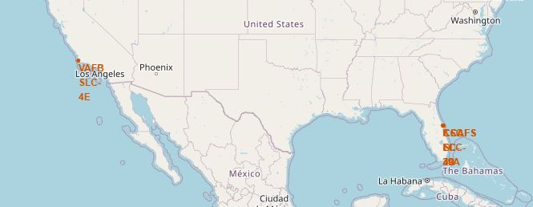
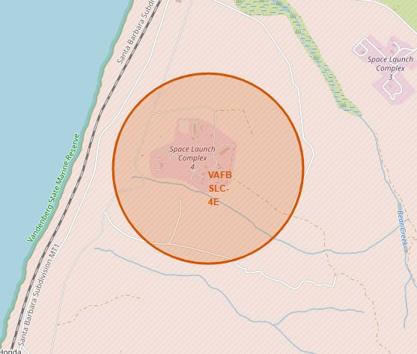
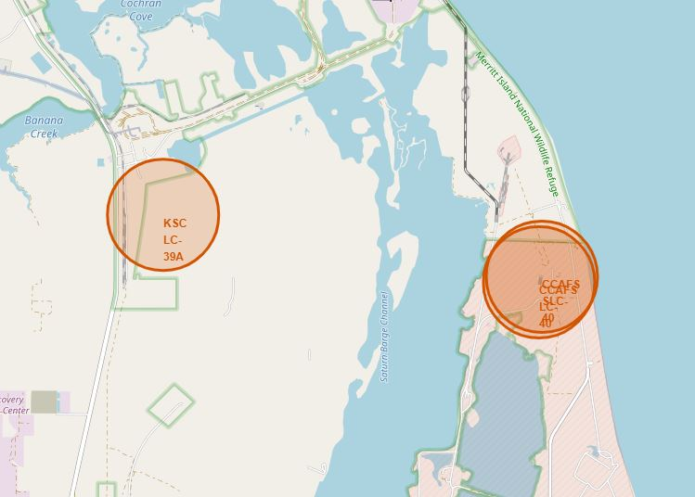
Markers of Launch Sites on the Map

Slide 36
Color Labeled Launch Outcomes on the Map
VAFB SLC-4E
KSC LC-39A
CCAFS SLC-40
CCAFS LC-40

Slide 37
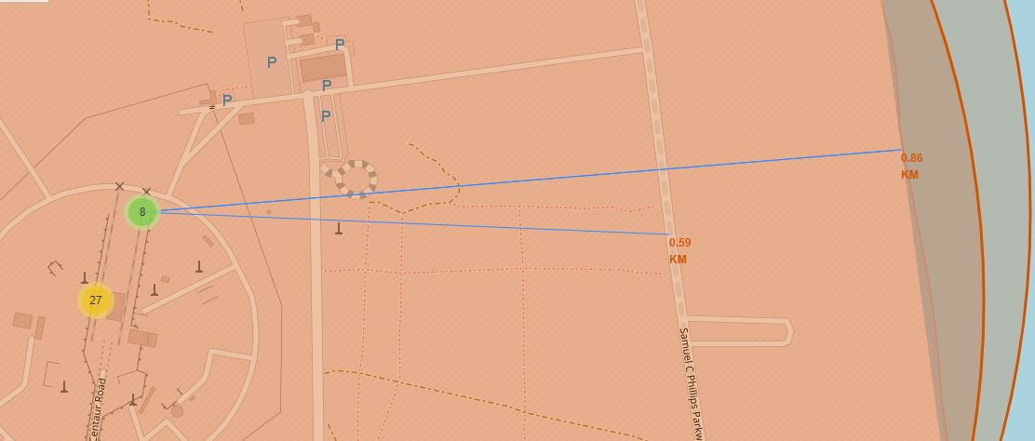
Proximities for a Launch Site
The launch site (CCAFS SLC-40 and CCAFS LC-40) has Proximities like highway and coastline.

Slide 38

Section 4

Slide 39

The Launch Success Count for All Sites
Each site and its landing success outcomes per percent.

Slide 40

Highest Launch Success Ratio Site
(CCAFS LC-40) has 73.1% of Landing success Outcomes.

Slide 41
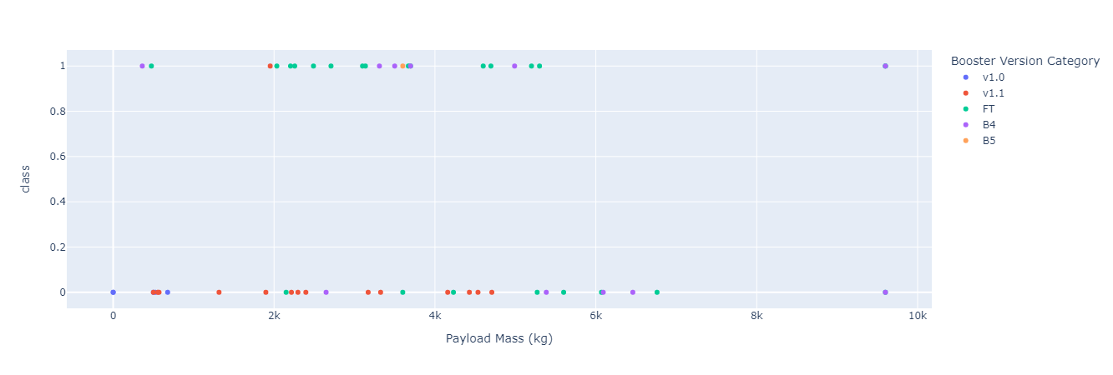
All Sites Payload vs. Launch Outcome
The success Outcomes is more when Booster version is (FT) with low Payload, and less when it is (v1.1)

Slide 42

Section 5

Slide 43
Classification Accuracy
The Accuracy of the all models has nearly the same value.

Slide 44
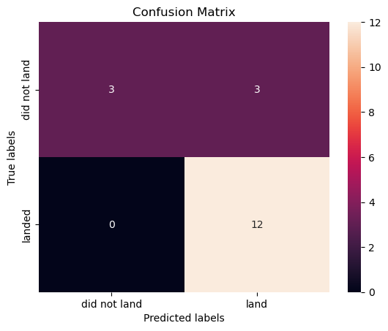
Confusion Matrix
The model predict all success landing samples rightly.
The model predict a half of the failure landing samples rightly.

Slide 45
Conclusions
Studied SpaceX data to figure out what and how features effect the return of the first stage of their rockets and build a prediction model for this process, Found that there is relation between (Flight Number), (Payload), (Orbit), (Booster version) and (Launch Site) against the Landing Outcomes.
As much as the (Flight Number) increase the Landing is more to success, such like Orbits (VLEO – LEO – SSO), Launch sites (VAFB SLC-4E – KSC LC-39A) and Booster versions (FB) on the other hand (Payload) increase cause the opposite.
Performed a predictive analysis and built a classification models like Logistic Regression, Support Vector Machine and Others models, evaluated by Confusion Matrix and Accuracy metrics, afford 83% of certainty to give the right Outcome, depending on the studied features.
The results are SpaceY can figure out what standards that has an effect on the landing process and predict whether their Rocket first stage will landing safety or not with 83% of certainty.

Slide 46
Appendix

Slide 47


